Slide 1
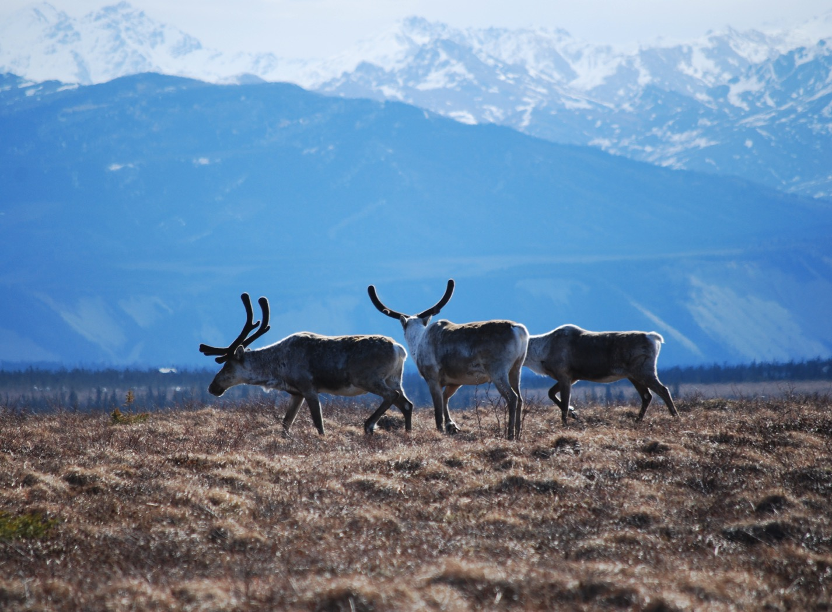
Arctic Boreal Vulnerability Experiment (ABoVE)
2017 ABoVE Airborne Campaign
30 July 2017 (DOY 211)
Charles Miller, Deputy Science Lead
Jet Propulsion Laboratory, California Institute of Technology
and the ABoVE Science Team For Hank Margolis, Eric Kasichke, Bruce Tagg
NASA HQ
May 2017

Slide 2
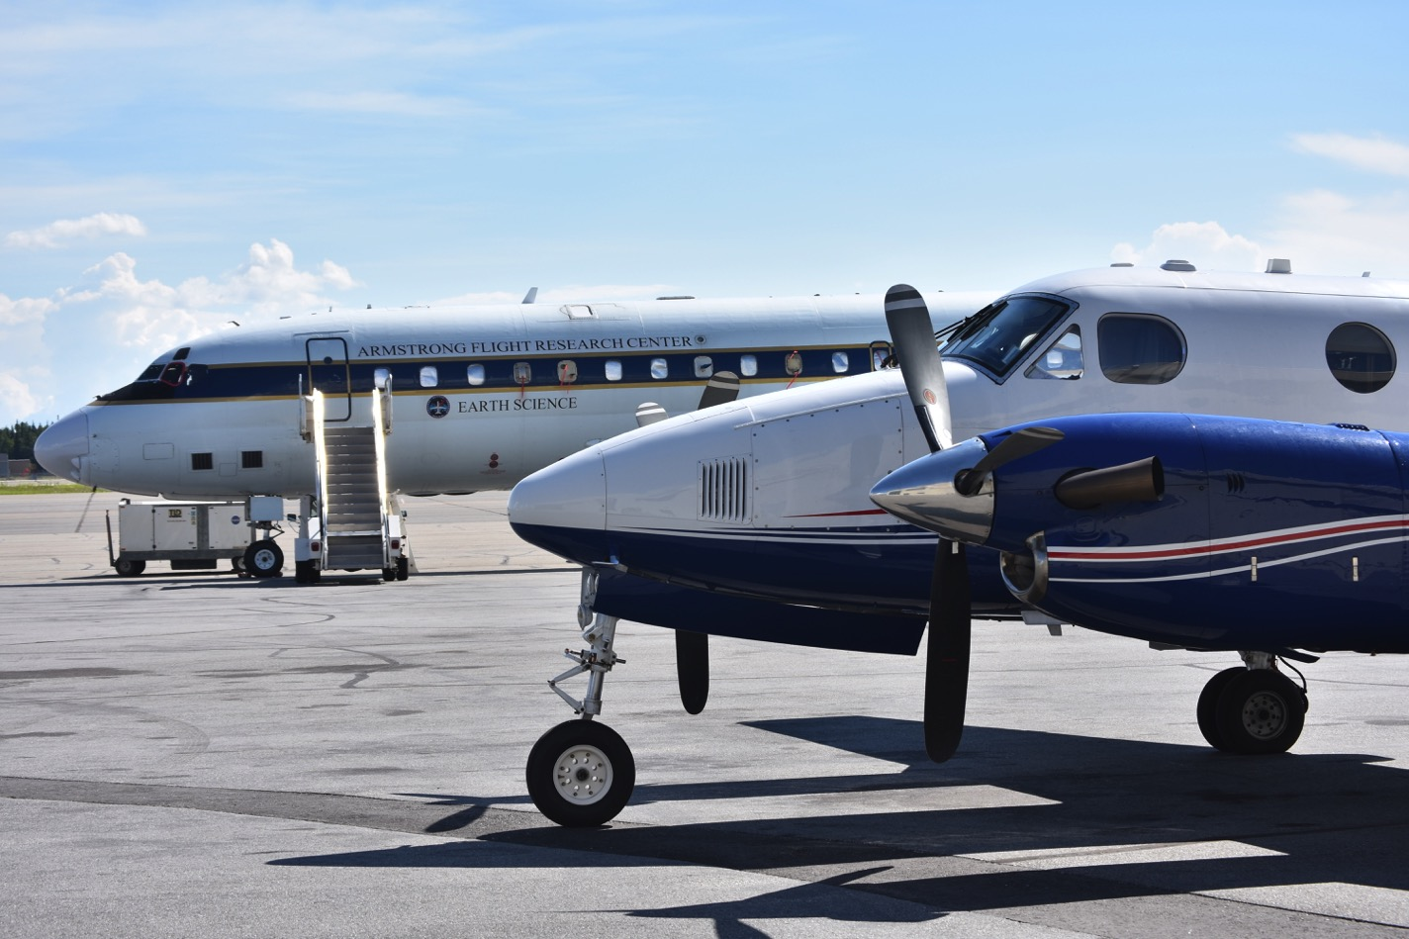
30 July 2017/DOY 211 AVIRIS Transit
N53W and the NASA DC8 at Fairbanks

Slide 3
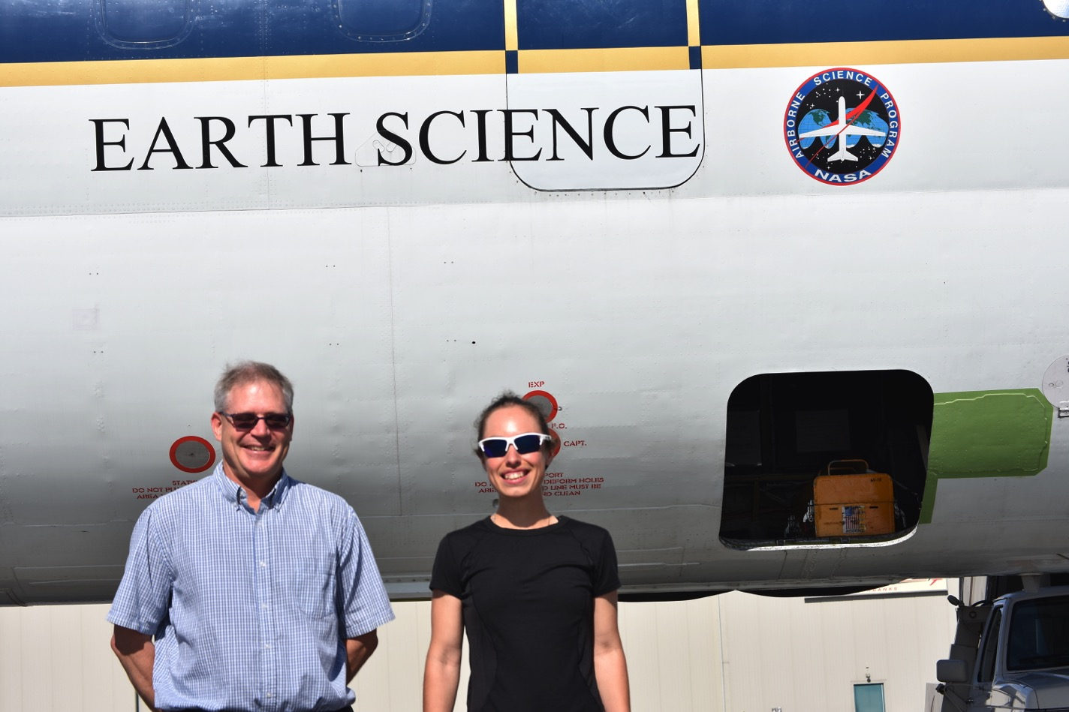
NEON and UAF reps visit the NASA DC8

